Slide 1

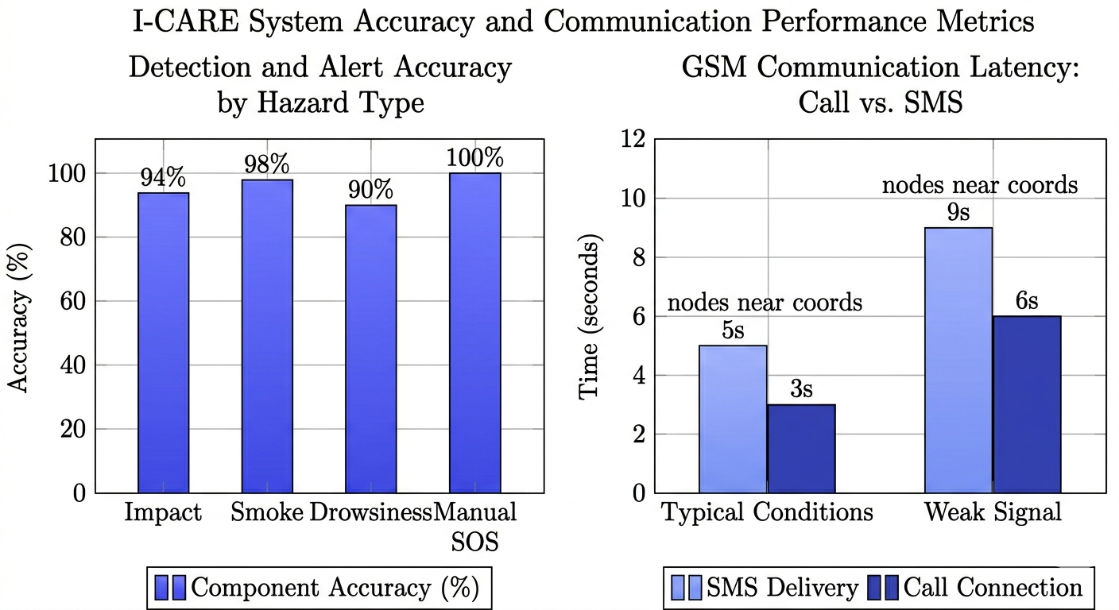
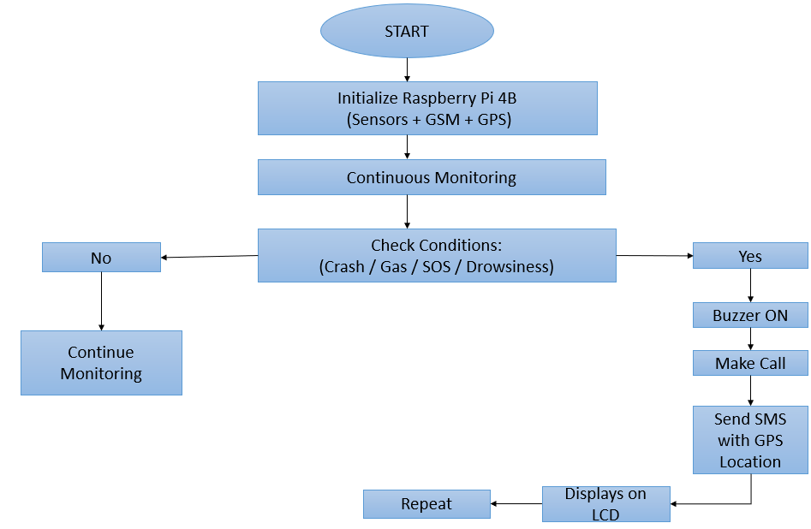
I-CARE : Intelligent Car Accident Response Emergency Locator
SRNs: 02FE22BEC054, 02FE22BEC058 Student Names: Priyanka, Pruthviraj Guide: Dr. D.A.Torse
Problem statement
Methodology
Results
Fatalities often result from the inability of incapacitated victims to call for help, leading to critical delays. Current systems lack integrated monitoring for driver fatigue and real-time hazard detection, preventing rapid medical intervention during the vital "Golden Hour."
Objectives
Automate Emergency Alerts: Instant crash detection and GPS transmission to minimize rescue delays.
Proactive Driver Monitoring: Real-time drowsiness detection using computer vision to prevent accidents.
Performance Analysis :The I-CARE system demonstrates high reliability with an average detection accuracy of 95.5% across all hazards, achieving 100% accuracy on manual SOS triggers. Communication testing confirms rapid response times, with emergency calls connecting in just 3 seconds and SMS alerts delivered within 5 seconds under typical conditions, ensuring medical intervention within the critical "Golden Hour."
Contributions
Literature survey
Conclusions
Multi-Hazard Integration: Unified crash, smoke, and drowsiness monitoring.
Automated Rescue Link: Instant GPS alerts to bypass the need for bystander intervention.
Fatigue Mitigation: Early accident prevention via real-time computer vision monitoring.
U. Alvi et al., "A Comprehensive Study on IoT Based Accident Detection Systems for Smart Vehicles," IEEE Access, vol. 8, 2020
Kishore S & Rekha R Nair, "Enhancing Road Safety: A Smart Accident Alert System for Rapid Emergency Response."
Nicky Kattukkaran et al., "Intelligent Accident Detection and Alert System for Emergency Medical Assistance
S. Saponara et al., "Real-time video fire/smoke detection based on CNN in antifire surveillance systems," Journal of Real-Time Image Processing, 2021
Kavyashree S Kulkarni et al., "Vehicle Accident Detection, Life-Saving & Smart Reporting System."
Proven Accuracy: Achieved 95.5% average detection accuracy, ensuring reliable identification of crashes, smoke, and driver fatigue.
Rapid Alerts: Reduced emergency response latency to under 10 seconds, maximizing survival during the critical "Golden Hour."
Human-Independent: Eliminated the need for bystander intervention through automated GPS reporting and real-time monitoring.
Critical Impact: Delivered a low-cost, high-reliability system for proactive accident prevention and instant emergency localization.
Capstone Project (20EECW402)
2025-26

